Slide 1
Intimidator is a 3 mode of action pre-emerge soybean herbicide that provides weed control performance with resistance management protection.

Slide 2
Three years of field testing proves performance of Intimidator.
Application timing: PPI, EP, Pre-emerge
Fomesafen Flexible: Use options with Intimidator pre f/b Top Gun post with glyphosate applications.
Use rates vary by geography. Refer to label.

Slide 3
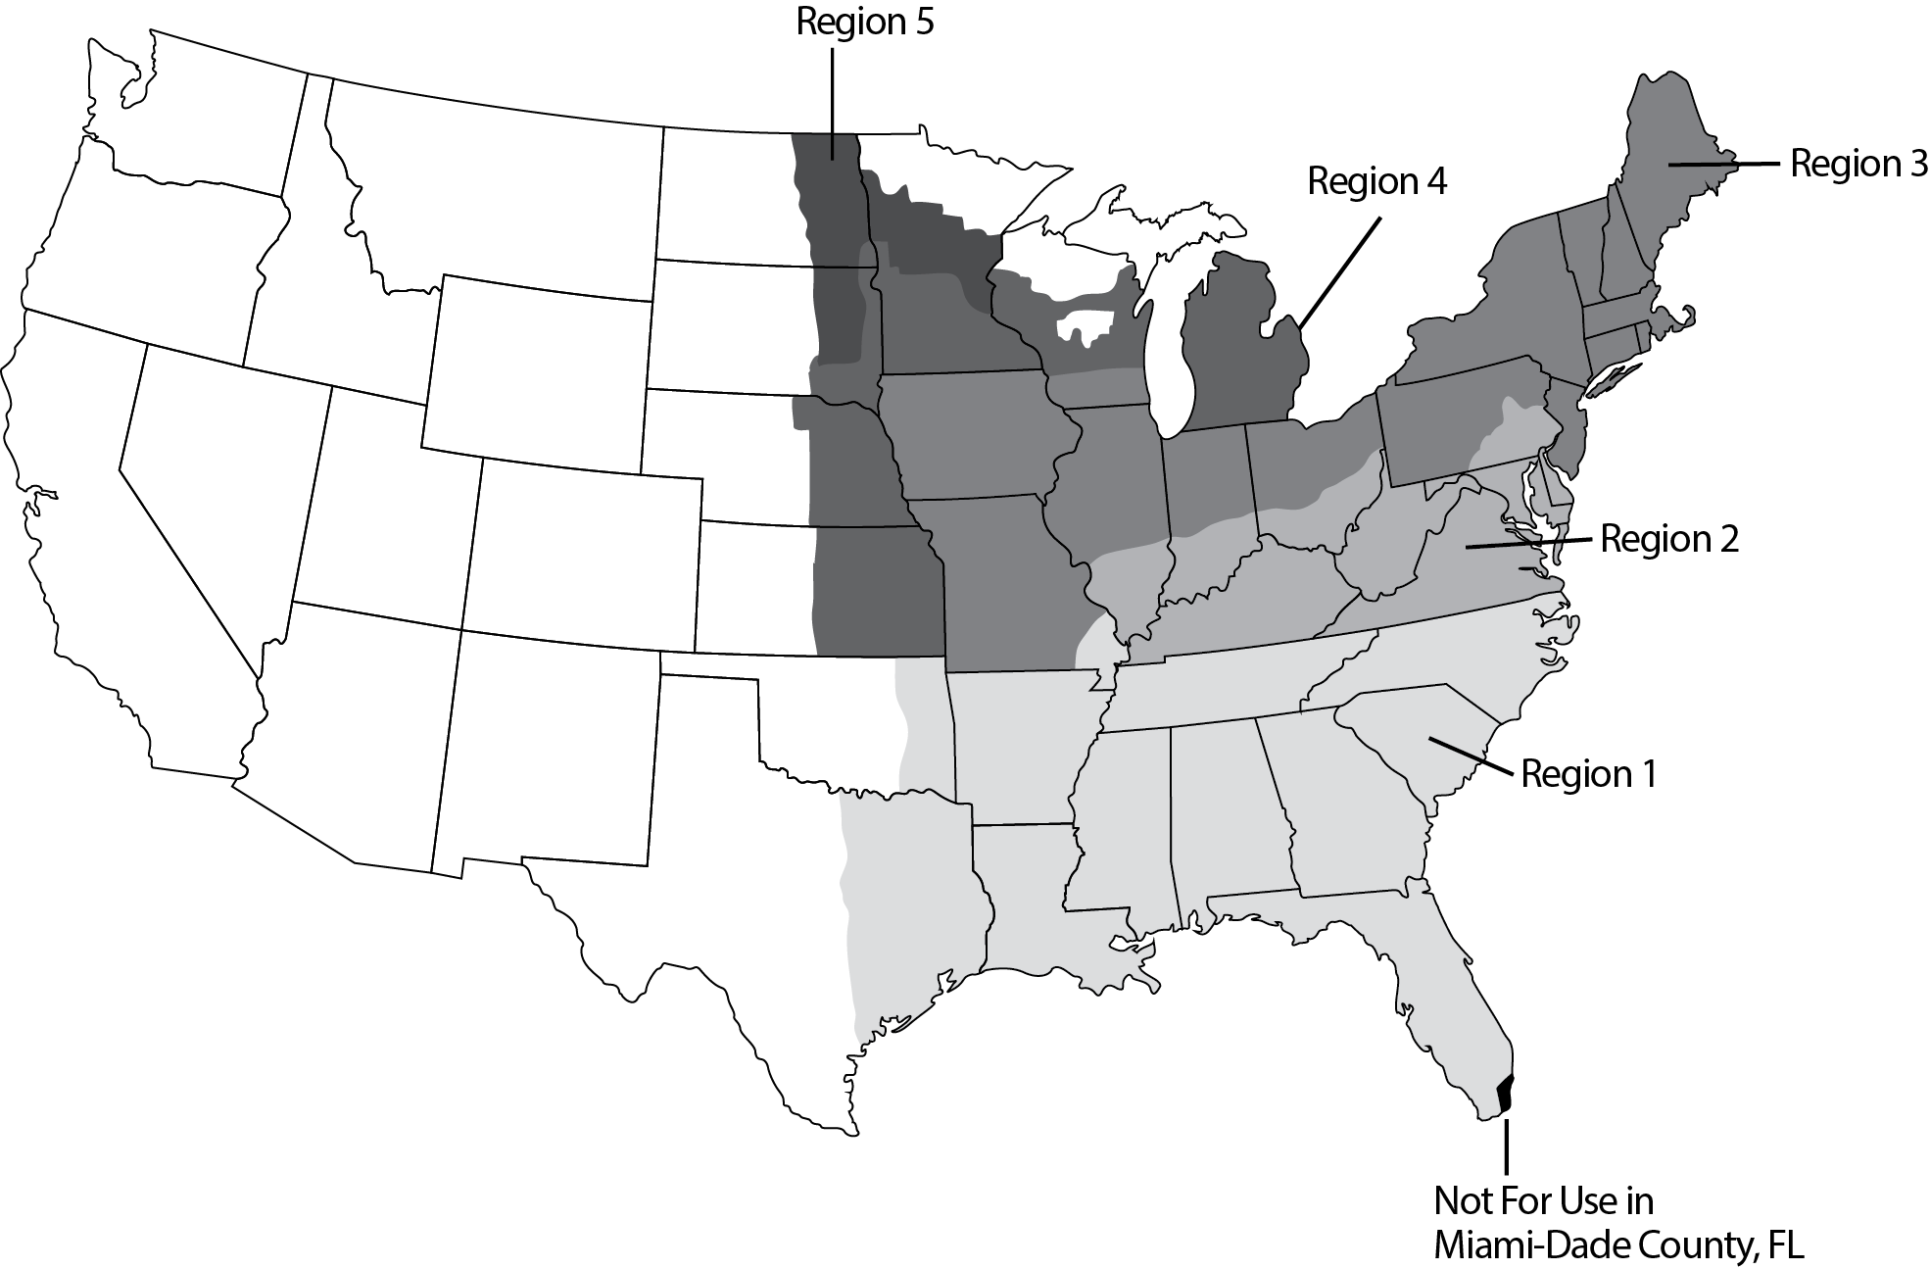
Refer to label for rates in your area

Slide 4
Fomesafen Flexibility
Intimidator Rate | Dual Magnum | Metribuzin | Fomesafen | Additional Top Gun Post w/gly.
1.0 pt | .44 pt | 2 oz | .33 pt | 12.0 oz
2.0 pt | .88 pt | 4 oz | .67 pt | 12.0 oz
3.0 pt | 1.33 pt | 6 oz | 1.0 pt | 8.0 oz
4.0 pt | 1.77 pt | 8 oz | 1.33 pt | 2.5 oz

Slide 5
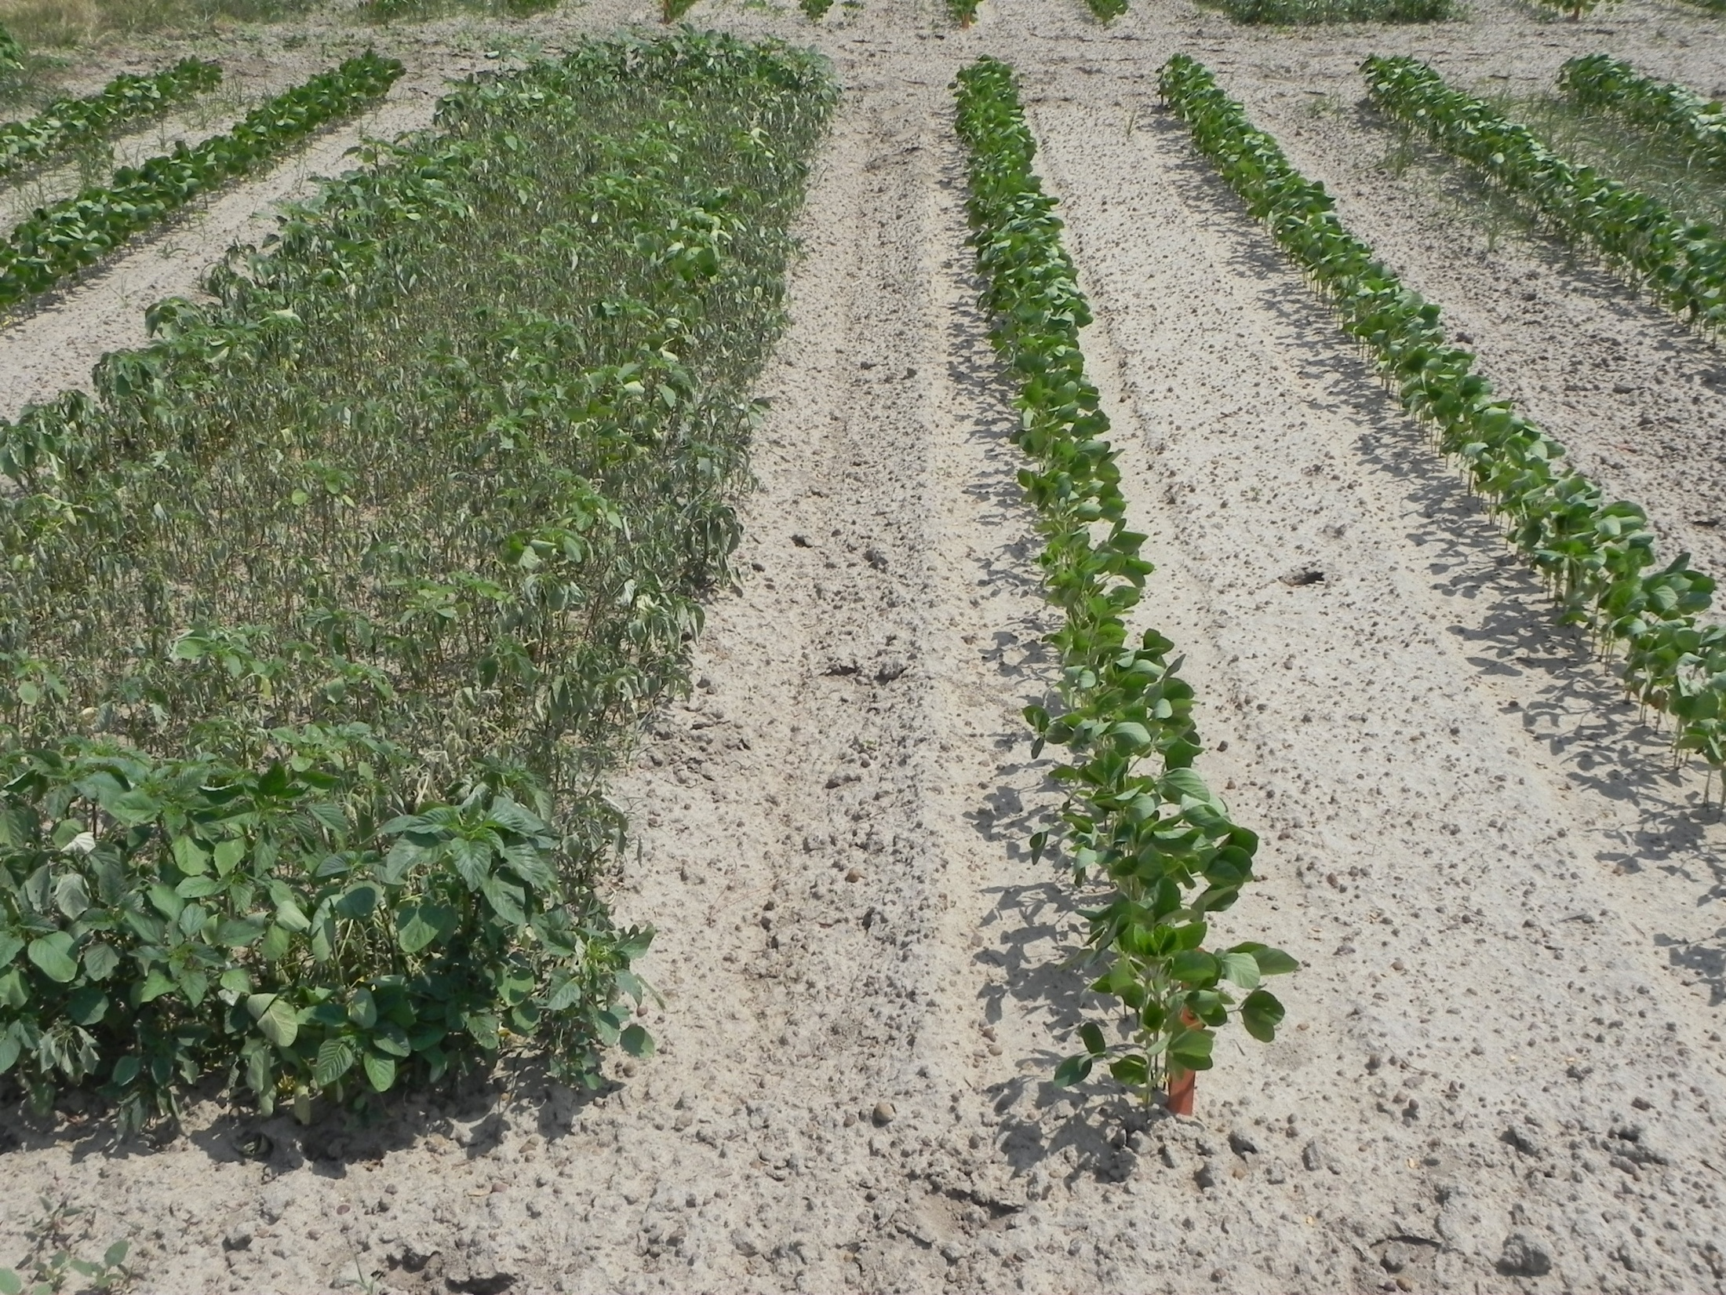
21 Days After Treatment – 3 pt.
2011 - UGA
Untreated Check

Slide 6
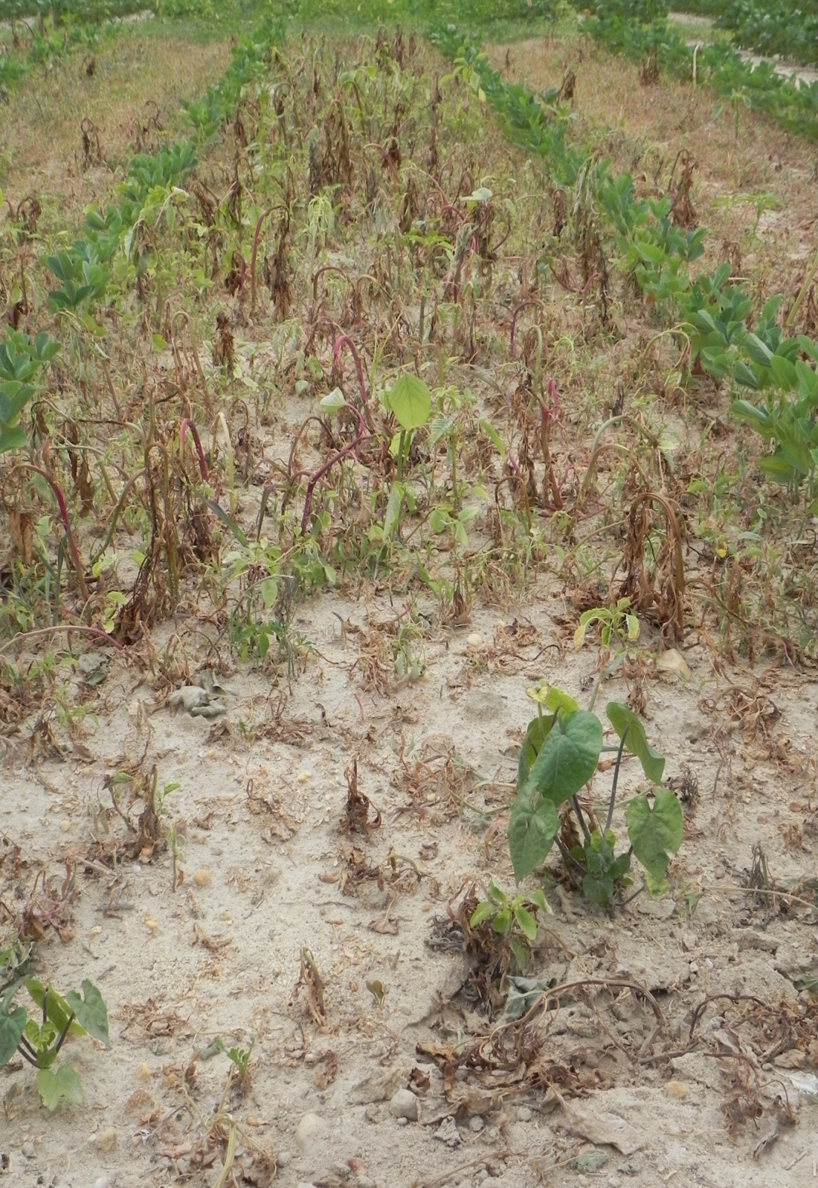
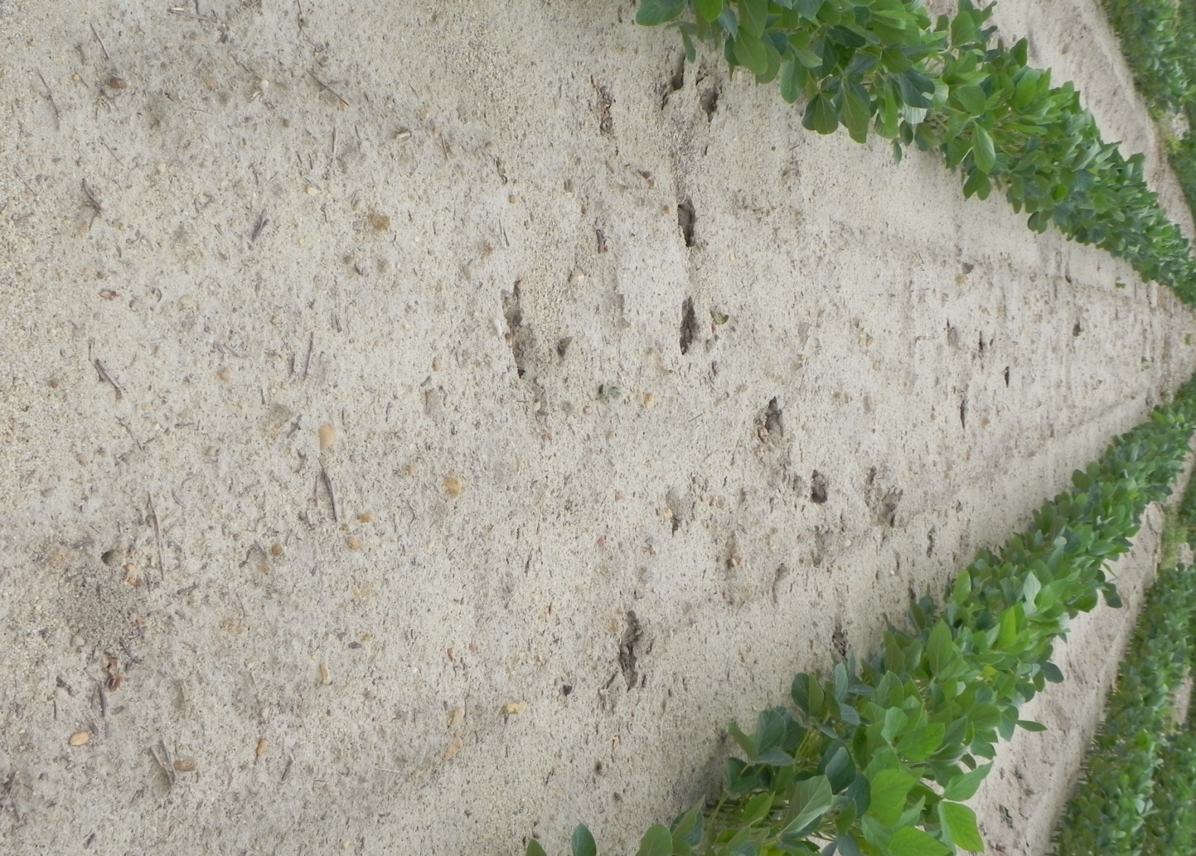
2011 - 30 DAT PRE, 10 DAT POST Clayton, NC
NO PRE Treatment,
Glyphosate 22 oz/A POST
3 pts/A PRE

