Slide 1

What is Matador?
Matador Pre-Emerge herbicide for grass & broadleaf weed control offers 3 Modes of Action providing a leading strategy for weed control and resistance management for soybeans.

Slide 2
Positioning
Benefits
3 Active Ingredients in One Product
Flexible application timing: PPI, Pre-plant, Pre-emerge
May tank-mix your burndown program with Matador for one pass convenience
Multiple modes of action for performance and resistance management
Convenient application timing for growers or custom application
State of the art formulation

Slide 3
Performance Components of Matador
Use Rate | Metolachlor | Metribuzin | Imazethapyr
2 pints | 1 pint | 3 ounces | 2 ounces
4 pints | 2 pints | 6 ounces | 4 ounces

Slide 4
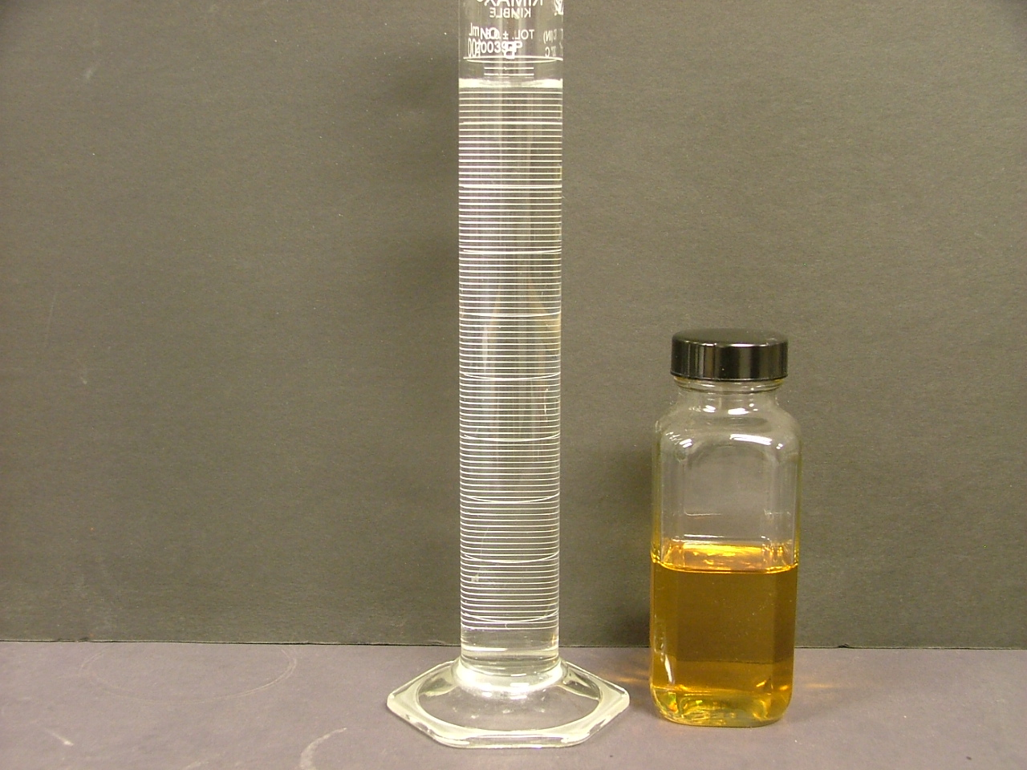
The Science Behind Matador Our Formulation Technology

Slide 5
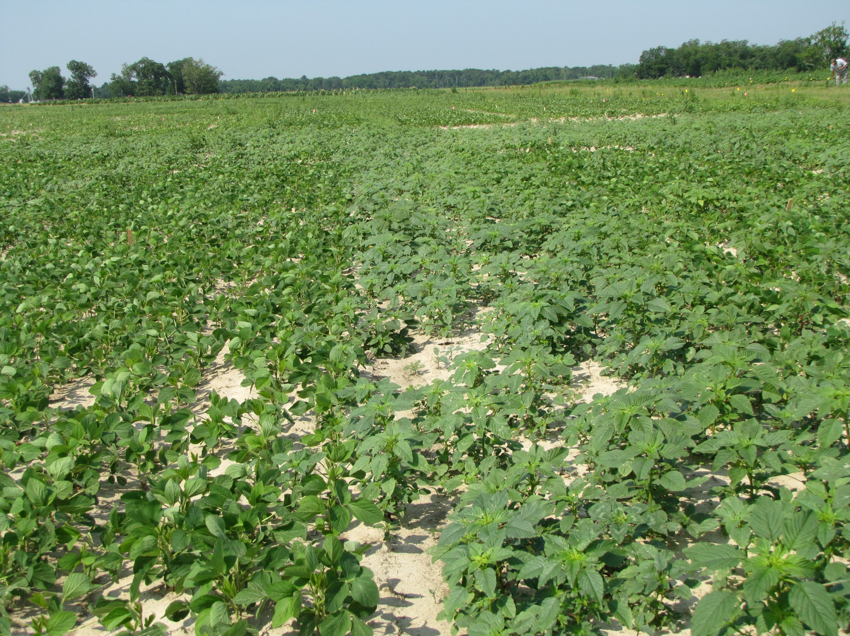
The Science of Matador
Check

